Slide 1
STEAM ACADEMY
Group 1

Slide 2
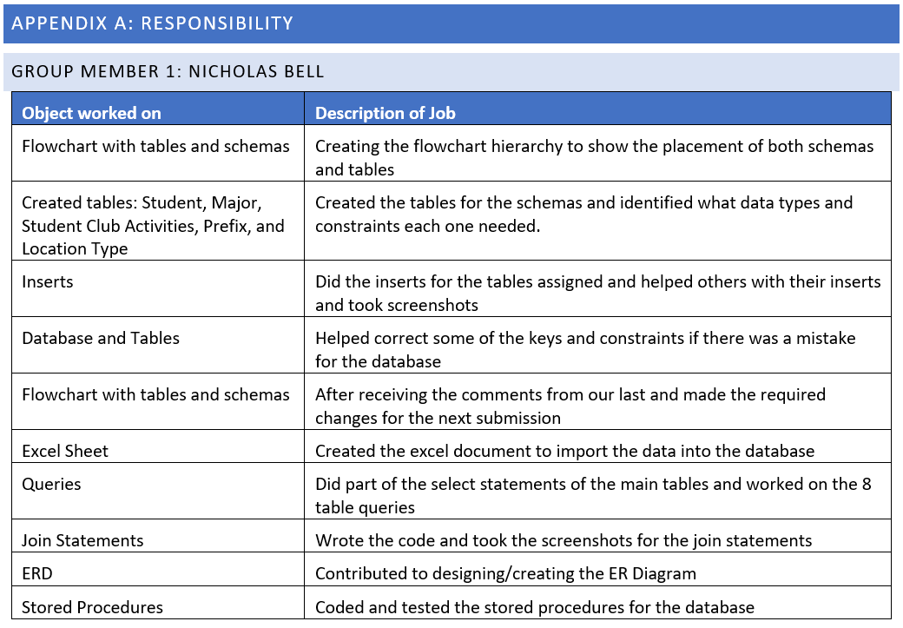

Group Member 1: Nicholas Bell
Year: Junior
Age: 21
Group Member 1: Nicholas Bell
Year: Junior
Age: 21

Slide 3
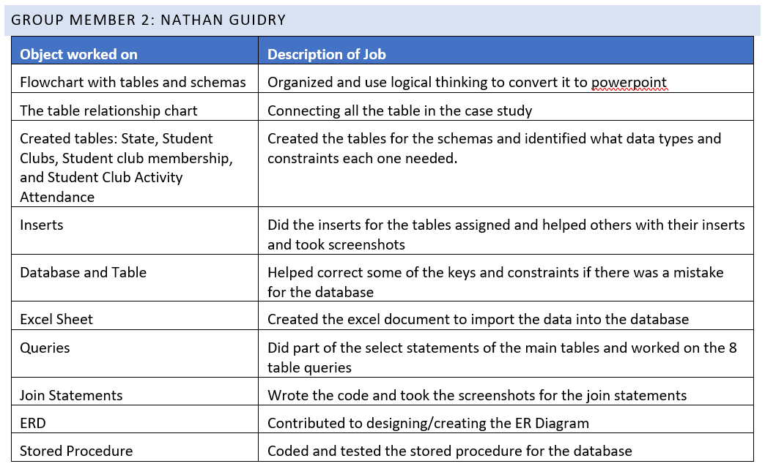

Group Member 2: Nathan Guidry
Year: Sophomore
Age: 19

Slide 4

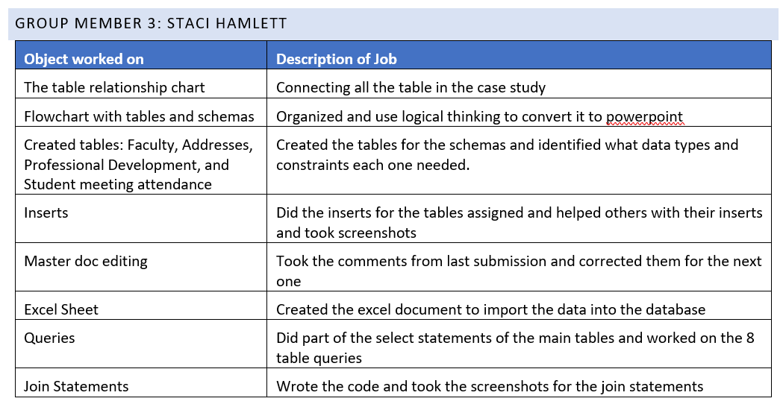
Group Member 3: Staci Hamlett
Year: Junior
Age: 20

Slide 5

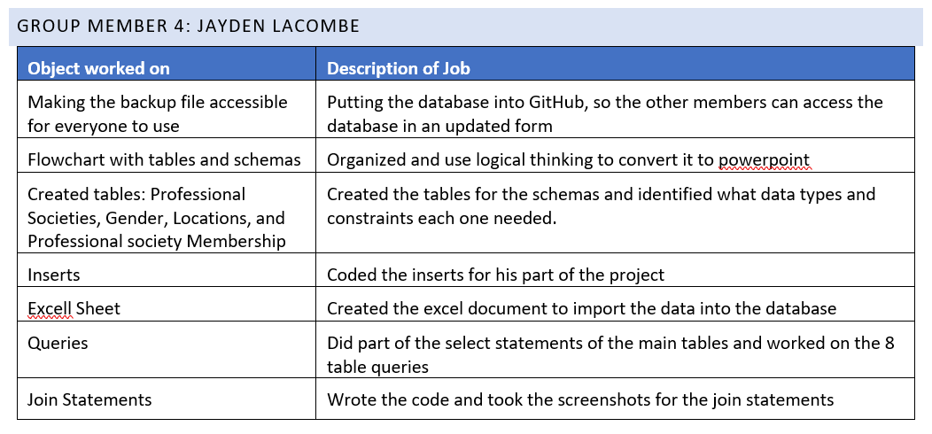
Group Member 4: Jayden Lacombe
Year: Sophomore
Age: 20

Slide 6

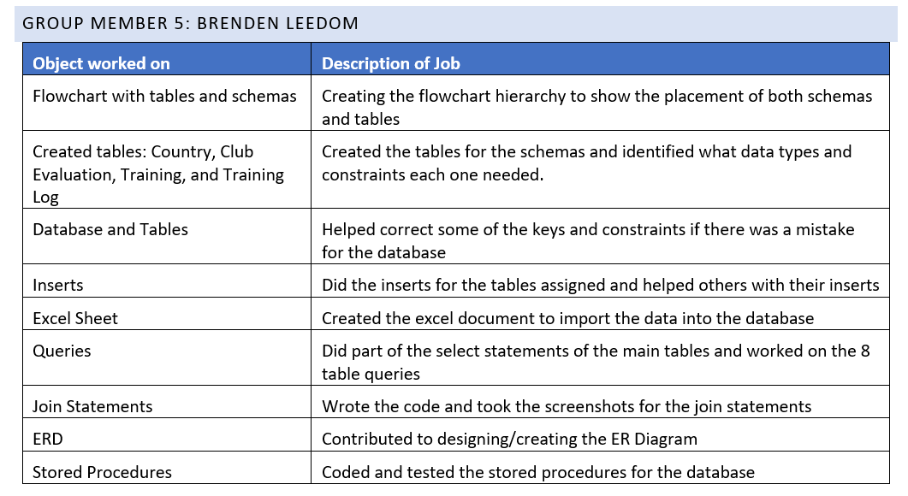
Group Member 5: Brenden Leedom
Year: Sophomore
Age: 20

Slide 7
Case Study Overview:
A professional society named STEAM Academy needs helps tracking contributions made by students with a working database.
STEAM Academy wants to make an annual report to give to their supervisors.
Annual reports will dictate which clubs will require more funding and resources.

Slide 8
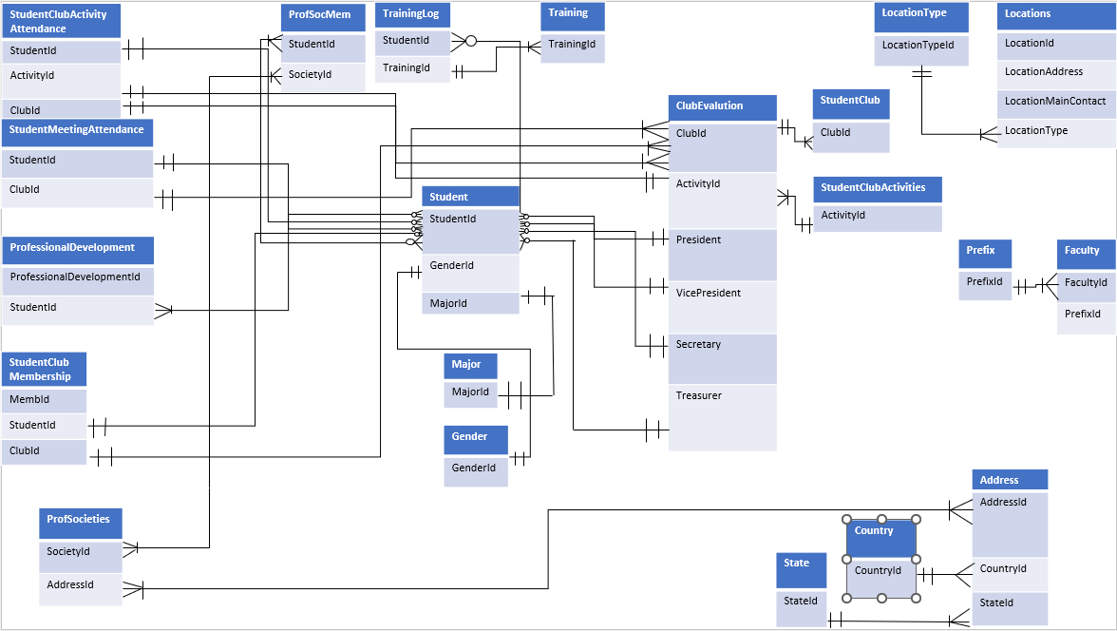
ER DIAGRAM
Relationships between tables
The Student table is the central table for the database
Bridge tables:
StudentClubActivityAttendance
StudentClubMembership
ProfessionalSocietyMembership
ClubEvaluation
TrainingLog

Slide 9
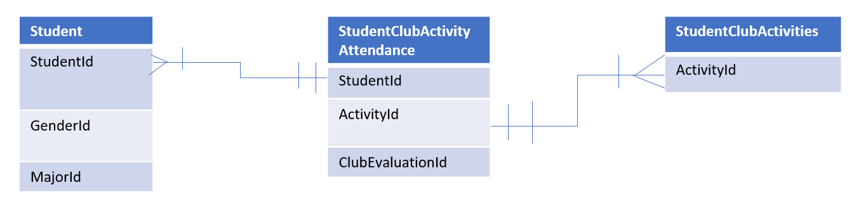
StudentClubActivityAttendance
Table uses StudentID and ActivityID
Bridges StudentClubActivities table and Student table
Keeps track of which student has attended which activity

Slide 10
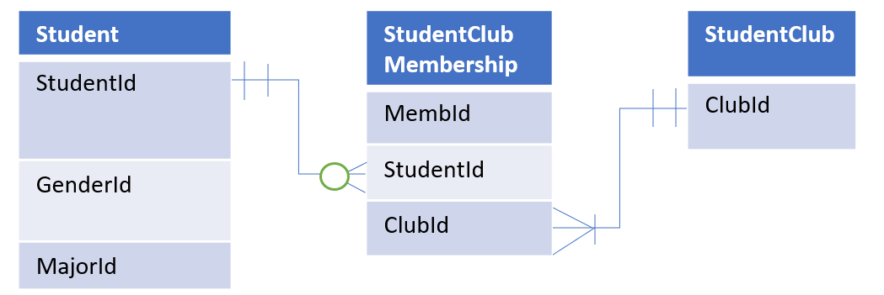
StudentClubMembership
Table uses StudentID and ClubID
Bridges Student table and StudentClub table
Links a MembershipID to both

Slide 11
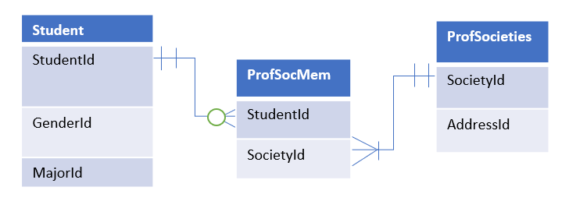
ProfessionalSocietyMembership
Table uses StudentID and SocietyID
Bridges Student table and ProfSocieties table
Provides membership tracking between the two

Slide 12
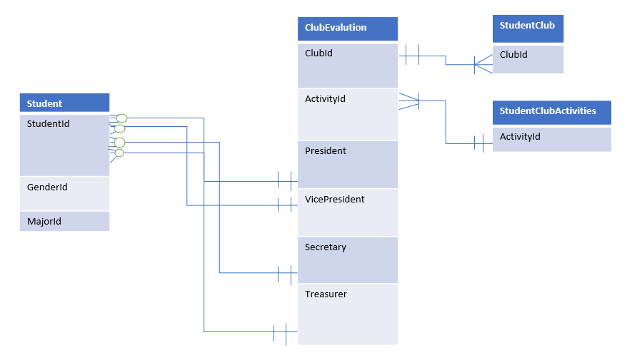
ClubEvaluation
Table uses StudentID, ClubID, and ActivityID
Links the Student table, StudentClub table, and StudentClubActivities table
Allows for the evaluation of clubs

Slide 13
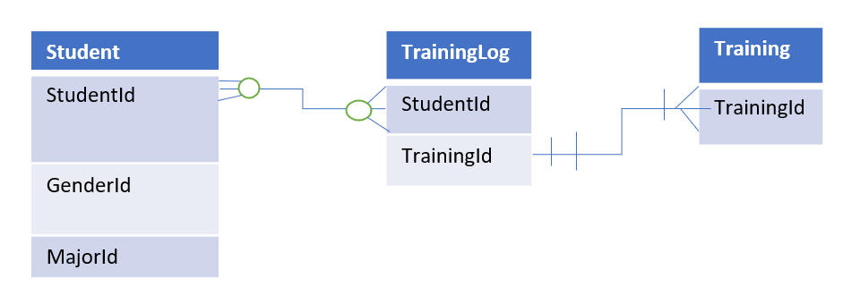
TrainingLog
Uses StudentID and TrainingID
Links Student table and Training table
Provides a dynamic log for keeping track of all training

Slide 14
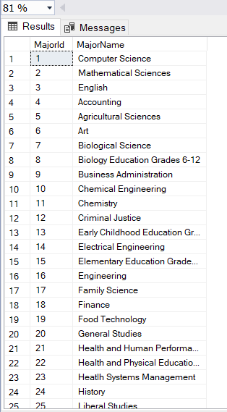
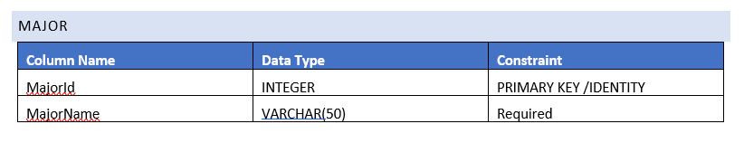
Major table
Creation and contents

Slide 15
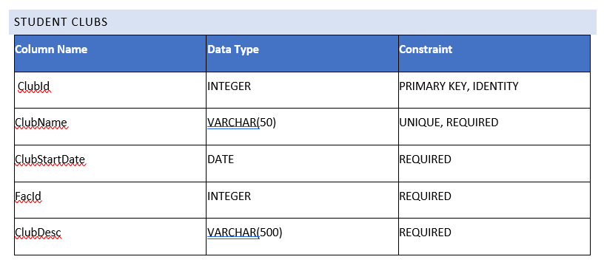
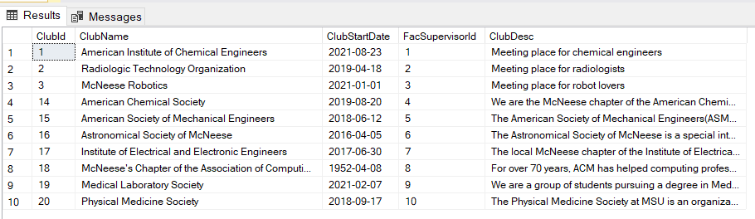
StudentClubs table
Creation and contents

Slide 16
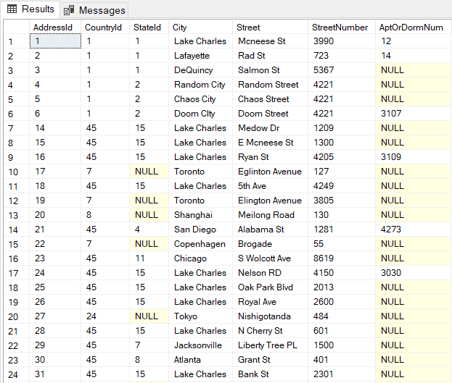
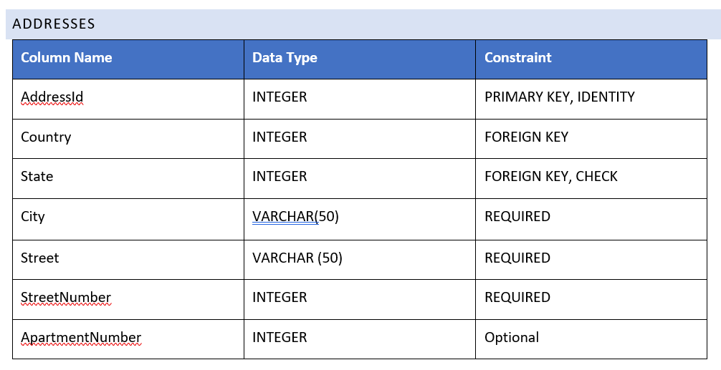
Address table
Creation and contents

Slide 17
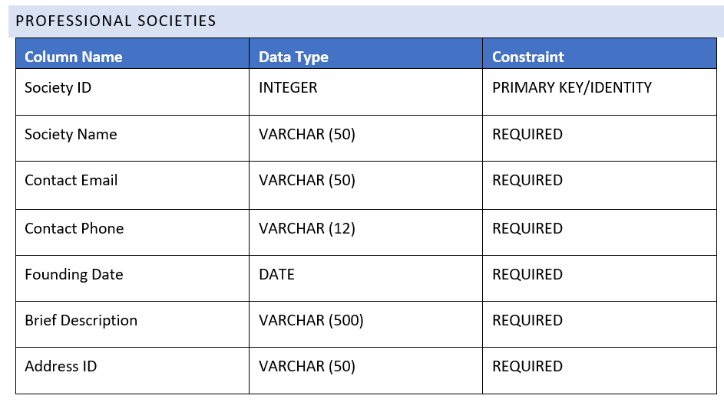
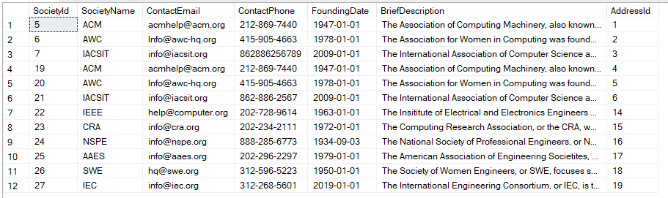
Professional Societies
Creation and contents

Slide 18
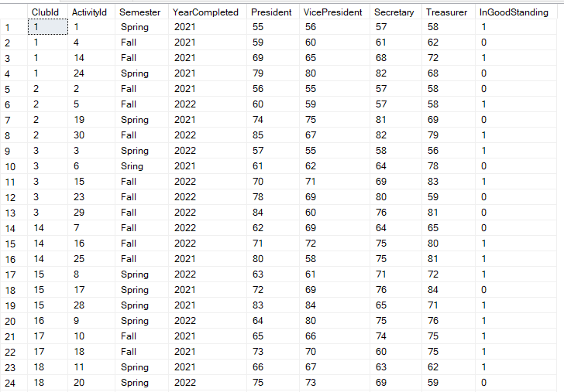
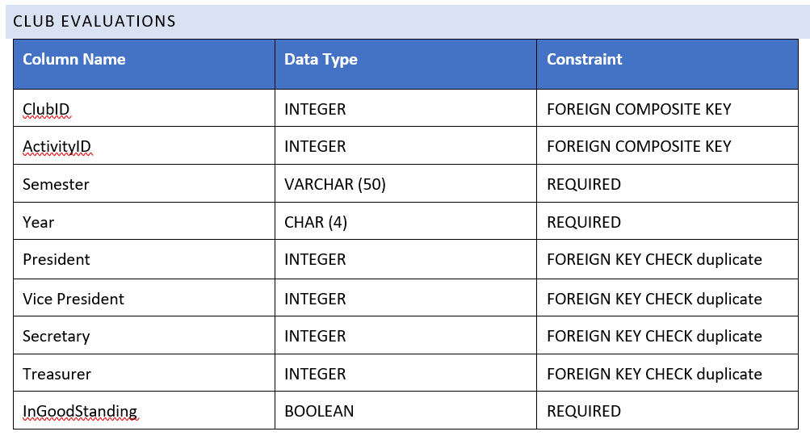
Club Evaluations
Creation and contents

Slide 19
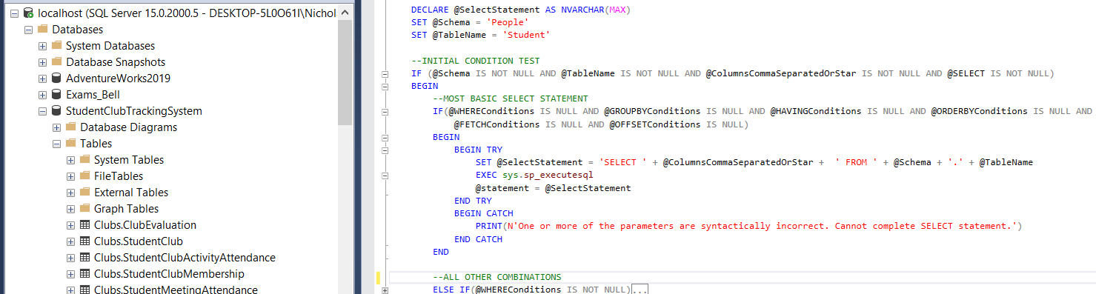
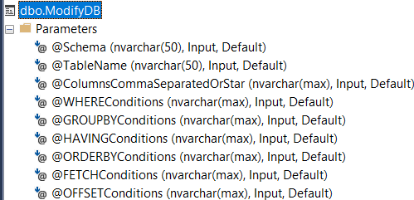
Stored procedures
SELECT STORED Procedure

Slide 20
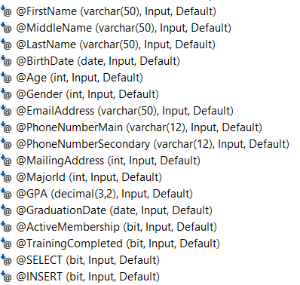
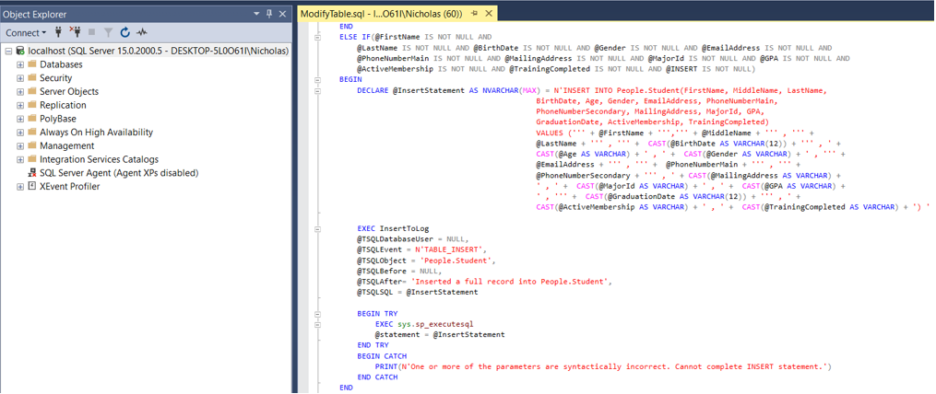
Stored Procedures
Insert STORED Procedure

Slide 21
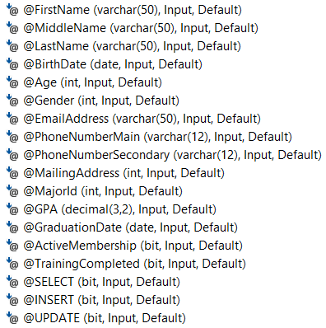
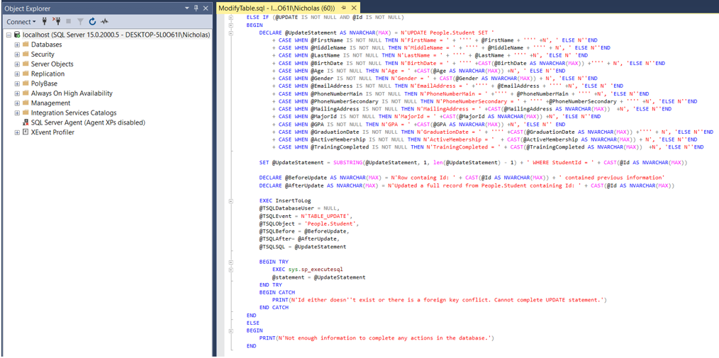
Stored Procedures
Update STORED Procedure

Slide 22
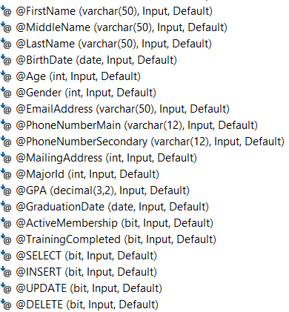
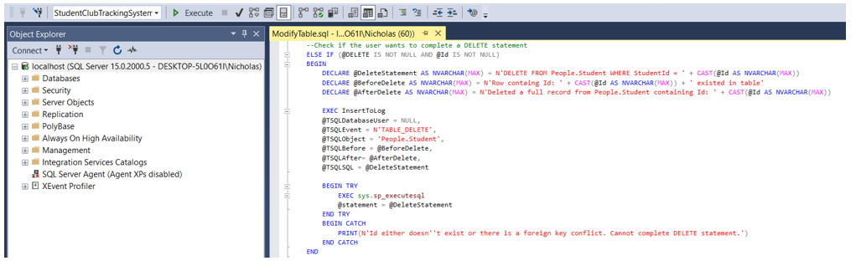
Stored Procedure
delete STORED Procedure

Slide 23
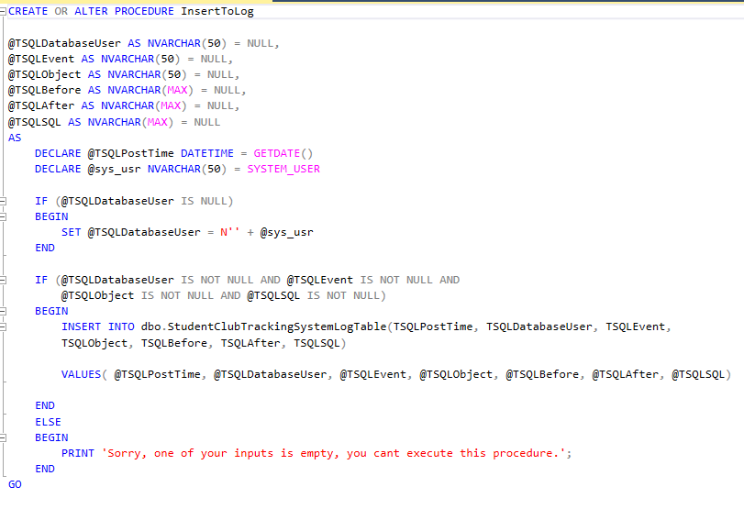
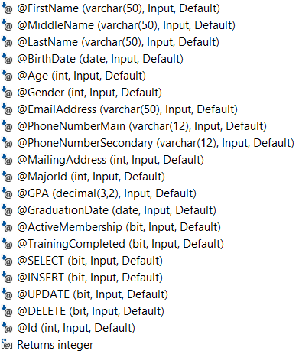
Stored Procedure
INSERT TO LOG

